Slide 1
Mini Hackathon - Time Series
JetRail Traffic Forecasting
Preparer:Mohamed Ziauddin Date:18-Sep-21

Slide 2
Problem Overview
Problem Statement
Task is to forecast the passenger traffic with the provided time series data.
Data set provided
train.csv - 18288 records with 3 columns
test.csv - 5112 records with 2 columns

Slide 3
Observations
No duplicates were found in the Train and Test dataset
No Null values were found in the Train and Test dataset
Date was found in the range (25-Aug-2012 to 25-Sep-2014) on an hourly basis in the Train dateset
Minimum of 2 and maximum of 1244 passengers has travelled in a single trip in the Train dataset
Expected Forecast for the date range (26-Sep-2014 to 26-Apr-2015) in the Test dataset

Slide 4
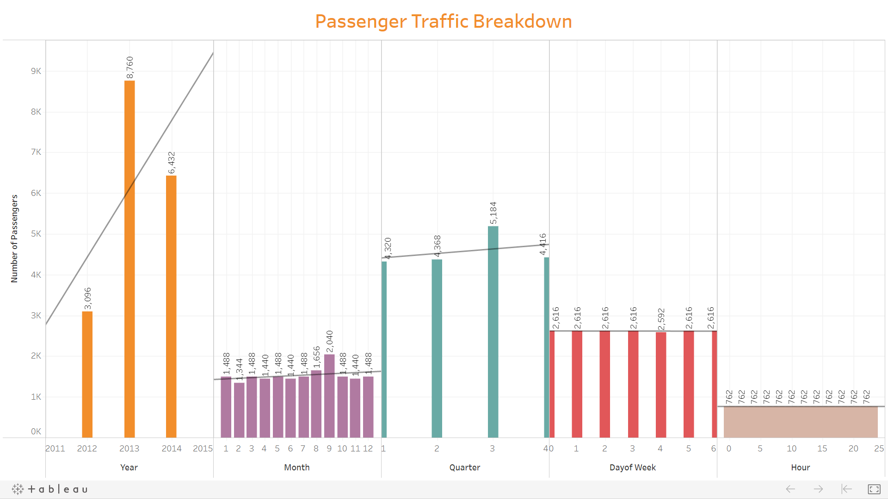
Data Analysis

Slide 5
Data Preperation
For using Regression, date was brokendown into Years, Months, Days, Quarter, etc
To standardize the values, scaling techniques(Standard/Min Max/Robust) were applied and all resulted the same
Encoding was used to categorize the date values

Slide 6
Model Analysis
Applied the following models and the best scores obtained
Model | RMSE Score | Accuracy Score
LinearRegression | 72.504 | 0.77678
LinearRegression-TR/SI/LI | 258.929 | 0.29425
FBProphet

Slide 7
Prediction Success Rate
Results of predicted output submitted as Target column in Test data
Model | Score
LinearRegression | 317.592
LinearRegression-TR/SI/LI | 295.390
FBProphet | 228.317

Slide 8
Conclusion
Out of the two models considered there were difference in the Regression compared with the FBprophet.
The model recommended is FBProphet for forecasting the passenger traffic

Slide 9
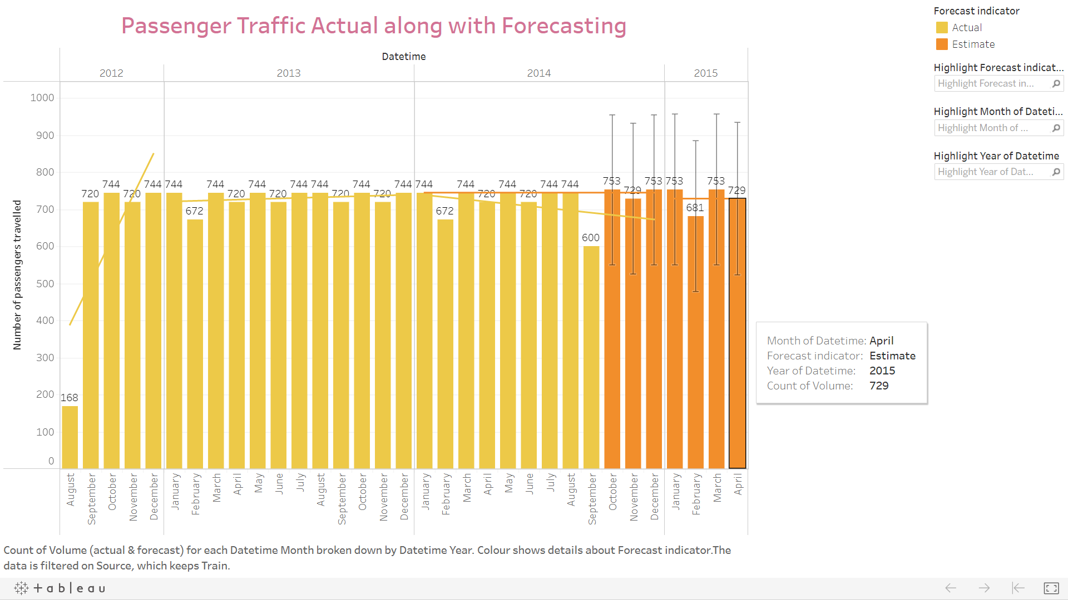
Forecasting Using Tableau

Slide 10
Using Tableau (Summary)
Options Used to Create Forecasts
Time series : Month of Datetime
Measures : Count of Volume
Forecast forward : 7 months (October 2014 - April 2015)
Forecast based on : August 2012 - September 2014
Ignore last : No periods ignored
Seasonal pattern : 12 month cycle
Count of Volume
Initial Change From Initial Seasonal Effect Contribution
October 2014 October 2014 - April 2015 High Low Trend Season Quality
753 ± 202 -24 May 2014 38 August 2014 -250 0.0% 100.0% Poor

Slide 11
Using Tableau (Summary)
All forecasts were computed using exponential smoothing.
Model Quality Metrics Smoothing Coefficients
Level Trend Season RMSE MAE MASE MAPE AIC Alpha Beta Gamma
Additive None Additive 103 51 1.03 11.8% 271 0.062 0.000 0.000

Slide 12
Thank You

